Slide 1

Dive into Deep Learning
Chapter 1:
Introduction

Slide 2
Contents
A Motivating Example
Data
Models
Kinds of Machine Learning
Supervised learning
The Road to Deep Learning
Success Stories
Roots
Summary
The Key Components
Objective functions
Optimization algorithms
Unsupervised learning
Interacting with an Environment
Reinforcement learning

Slide 3
Contents
CH1
A Motivating Example
The Key Components
Kinds of Machine Learning
Roots
The Road to Deep Learning
Success Stories
Summary
Data
Supervised learning
Models
Unsupervised learning
Objective functions
Interacting with an Environment
Optimization algorithms
Reinforcement learning

Slide 4
Contents
CH1
A Motivating Example
The Key Components
Kinds of Machine Learning
Roots
The Road to Deep Learning
Success Stories
Summary
Data
Supervised learning
Models
Unsupervised learning
Objective functions
Interacting with an Environment
Optimization algorithms
Reinforcement learning

Slide 5
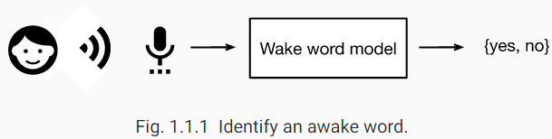
A Motivating Example
Write a program to respond to a wake word like “Alexa”, “Okay, Google” or “Siri”.
What rule could map reliably from a snippet of raw audio to confident predictions {yes, no} on whether the snippet contains the wake word?
In ML approach:
Collect a dataset containing examples of audio and label those that do and that do not contain the wake word.
Define a program (model) whose behaviour is determined by a number of parameters.
Use the dataset to determine the best possible set of parameters to improve the performance of our program.
The set of all distinct programs (input-output mappings) produced by manipulating the parameters is called a family of models.
The meta-program that uses our dataset to choose the parameters is called a learning algorithm.

Slide 6
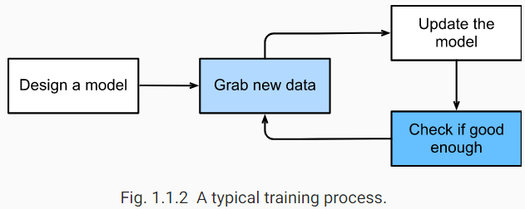
A Motivating Example
In deep learning, the learning is the process by which we discover the right setting of the parameters coercing the desired behaviour from our model.
The training process usually looks like this:
Start off with a randomly initialized model that cannot do anything useful.
Grab some of your labeled data (e.g., audio snippets and corresponding {yes, no} labels).
Tweak the parameters to improve the model’s performance.
Repeat until the model is awesome.

Slide 7
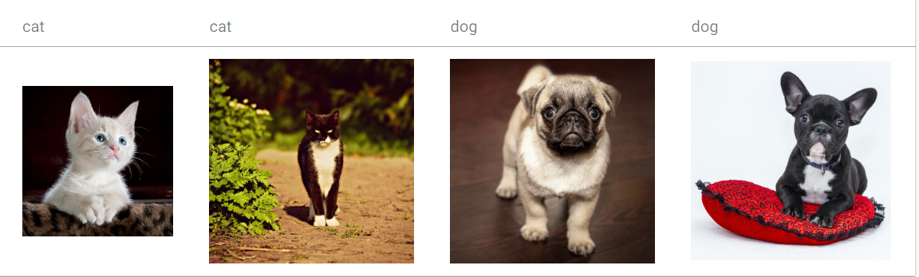
A Motivating Example
To summarize, rather than code up a wake word recognizer, we code up a program that can learn to recognize wake words, if we present it with a large labeled dataset.
Think of this act of determining a program’s behaviour by presenting it with a dataset as programming with data.
We can “program” a cat detector by providing our machine learning system with many examples of cats and dogs, such as the images below:
In this way the detector will learn to emit a very large positive number if it is a cat, a very large negative number if it is a dog, and something closer to zero if it is not sure, and this barely scratches the surface of what ML can do.

Slide 8
A Motivating Example
Deep learning is just one among many popular methods for solving machine learning problems.
Important points about deep learning:
The problems that we have discussed previously are problems where deep learning excels and where traditional ML methods faltered.
Deep models are deep in precisely the sense that they learn many layers of computation.
These many-layered (or hierarchical) models are capable of addressing low-level perceptual data.
Deep learning replaces the shallow models the labour-intensive process of feature engineering.
Deep learning offers a unified set of tools for tackling diverse problems.

Slide 9
Contents
CH1
A Motivating Example
The Key Components
Kinds of Machine Learning
Roots
The Road to Deep Learning
Success Stories
Summary
Data
Supervised learning
Models
Unsupervised learning
Objective functions
Interacting with an Environment
Optimization algorithms
Reinforcement learning

Slide 10
The Key Components
The core components of ML problems are:
1
2
The data we can learn from
A model of how to transform the data
A loss function that quantifies the badness of our model
3
An algorithm to adjust the model’s parameters to minimize the loss
4

Slide 11
The Key Components
The core components of ML problems are:
1
2
The data we can learn from
A model of how to transform the data
A loss function that quantifies the badness of our model
3
An algorithm to adjust the model’s parameters to minimize the loss
4

Slide 12
The Key Components: Data
Generally, we are concerned with a collection of examples.
Each example typically consists of a collection of numerical attributes called features.
A special feature is designated as the prediction target, (sometimes called the label or dependent variable).
The given features from which the model must make its predictions are called the features,
(or often, the inputs, covariates, or independent variables).
If each example has the same number of numerical values, we say the data consists of fixed-length vectors.
We describe the (constant) length of the vectors as the dimensionality of the data.
Not all data can easily be represented as fixed-length vectors.
For images of different length, we can crop the images to a fixed size but we risk loosing in the cropped out portion.
Text data (such as collected from e-commerce websites- Amazon) resists fixed-length representation.
Modern models of deep learning can handle varying-length data.

Slide 13
A Motivating Example: Data
The more data we have, the more powerful models we can train.
many of the most exciting models in deep learning do not work without large datasets. Some others work in the low-data regime, but are no better than traditional approaches.
Besides having lots of data and processing it cleverly, we need the right data.
If the data is full of mistakes, or if the chosen features are not predictive of the target quantity of interest, learning is going to fail
In sensitive applications, we must be careful about choosing the dataset.
Garbage dataset results in garbage model- a model with poor predictive performance.
Examples of sensitive applications: cancer recognition, predictive policing, and risk models used for lending.
Failure can also occur when the data does not under-represent some groups but reflects societal prejudices.
Example: Hiring decisions that based on historical injustices.

Slide 14
The Key Components
The core components of ML problems are:
1
2
The data we can learn from
A model of how to transform the data
A loss function that quantifies the badness of our model
3
An algorithm to adjust the model’s parameters to minimize the loss
4

Slide 15
The Key Components: Models
A model is a computational machinery for ingesting data of one type, and produce predictions.
In particular, we are interested in statistical models that can be estimated from data.
Model
Data
Predictions
Deep learning is characterized by a set of powerful models that consist of many successive transformations of the data that are chained together top to bottom

Slide 16
The Key Components
The core components of ML problems are:
1
2
The data we can learn from
A model of how to transform the data
A loss function that quantifies the badness of our model
3
An algorithm to adjust the model’s parameters to minimize the loss
4

Slide 17
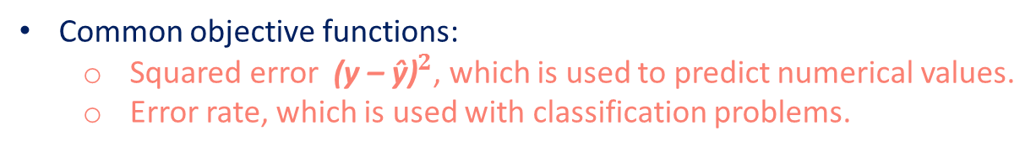
The Key Components: Objective functions
The concept of learning means improving at some task.
Q: What constitutes an improvement? A: Objective (or loss) function.
The objective function is a formal mathematical system that measures how good (or bad) our models are.
Conventionally, the objective function is defined that lower is better.
Alternatively, we can take any function f where higher is better, and turn it into f’ where lower is better by setting f’ = -f
Considering the case where lower is better, the objective function is called loss or cost function.
Common objective functions:
Squared error ${\text{(}\text{y} \text{– }\text{ŷ}\text{)}}^{2}$, which is used to predict numerical values.
Error rate, which is used with classification problems.

Slide 18
The Key Components: Objective functions
Squared error function is easy to optimize but error rate is difficult to optimize.
Functions that are difficult to optimize can be substituted by surrogate objective.
A surrogate is a function that approximates an objective function as it takes little time to evaluate. [ https://www.mathworks.com/help/gads/what-is-surrogate-optimization.html ]
The loss function is defined with respect to the model’s parameters and depends upon the dataset.
The best values of our model’s parameters are learned by minimizing the loss incurred on a training set.
However, doing well on the training data does not guarantee that we will do well on (unseen) test data.
Typically we split the available data into two partitions:
Training data for fitting model parameters.
Test data which is held out for evaluation.
Such data splitting reports the following two quantities:
Training error: The error on that data on which the model was trained.
Test Error: This is the error incurred on an unseen test set.

Slide 19
The Key Components
The core components of ML problems are:
1
2
The data we can learn from
A model of how to transform the data
A loss function that quantifies the badness of our model
3
An algorithm to adjust the model’s parameters to minimize the loss
4

Slide 20
The Key Components: Optimization algorithms
Given a dataset and its representation, a model, and an objective function, we need an optimization algorithm.
An optimization algorithm is an algorithm that is capable of searching for the best possible parameters for minimizing the loss function.
The most popular optimization algorithms for neural networks follow an approach called gradient descent.
In gradient descent approach (depicted in the figure below), at each step:
It check to see, for each parameter, which way the training set loss would move if you perturbed that parameter just a small amount.
They then update the parameter in the direction that reduces the loss.
loss
Value of a parameter

Slide 21
Contents
CH1
A Motivating Example
The Key Components
Kinds of Machine Learning
Roots
The Road to Deep Learning
Success Stories
Summary
Data
Supervised learning
Models
Unsupervised learning
Objective functions
Interacting with an Environment
Optimization algorithms
Reinforcement learning

Slide 22
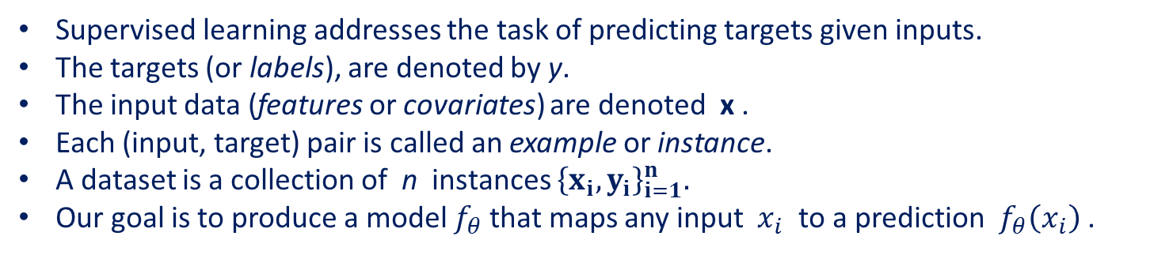
Kinds of Machine Learning: Supervised learning
Supervised learning addresses the task of predicting targets given inputs.
The targets (or labels), are denoted by y.
The input data (features or covariates) are denoted x .
Each (input, target) pair is called an example or instance.
A dataset is a collection of n instances ${\left\{x_{i},y_{i}\right\}}_{i=1}^{n}.$
Our goal is to produce a model $f_{θ}$that maps any input $x_{i}$ to a prediction $f_{θ}\left(x_{i}\right)$ .
Sepal length | Sepal width | Petal length | Petal width | Species
5.1 | 3.5 | 1.4 | 0.2 | setosa
4.9 | 3.0 | 1.4 | 0.2 | setosa
7.0 | 3.2 | 4.7 | 1.4 | versicolor
6.4 | 3.2 | 4.5 | 1.5 | versicolor
7.2 | 3.6 | 6.1 | 2.5 | virginica
6.5 | 3.2 | 5.1 | 2.0 | virginica
Example of Iris dataset

Slide 23
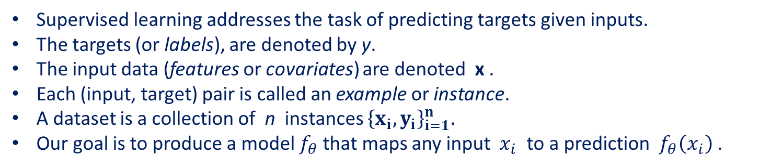
Kinds of Machine Learning: Supervised learning
Supervised learning addresses the task of predicting targets given inputs.
The targets (or labels), are denoted by y.
The input data (features or covariates) are denoted x .
Each (input, target) pair is called an example or instance.
A dataset is a collection of n instances ${\left\{x_{i},y_{i}\right\}}_{i=1}^{n}.$
Our goal is to produce a model $f_{θ}$that maps any input $x_{i}$ to a prediction $f_{θ}\left(x_{i}\right)$ .
Sepal length | Sepal width | Petal length | Petal width | Species
5.1 | 3.5 | 1.4 | 0.2 | setosa
4.9 | 3.0 | 1.4 | 0.2 | setosa
7.0 | 3.2 | 4.7 | 1.4 | versicolor
6.4 | 3.2 | 4.5 | 1.5 | versicolor
7.2 | 3.6 | 6.1 | 2.5 | virginica
6.5 | 3.2 | 5.1 | 2.0 | virginica
Features or covariates
Labels
Instance or example
Example of Iris dataset

Slide 24
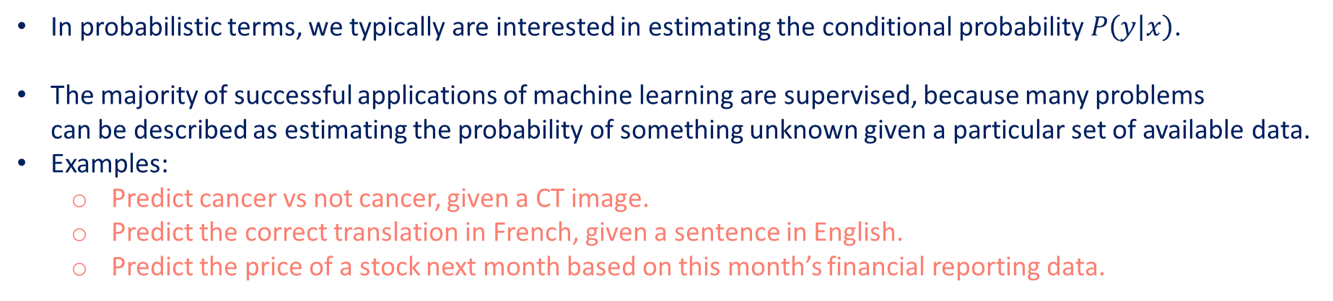
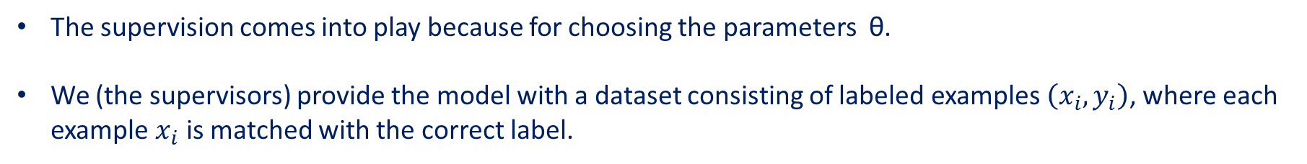
Kinds of Machine Learning: Supervised learning
The supervision comes into play because for choosing the parameters θ.
We (the supervisors) provide the model with a dataset consisting of labeled examples $\left(x_{i},y_{i}\right)$, where each example $x_{i}$ is matched with the correct label.
In probabilistic terms, we typically are interested in estimating the conditional probability $P\left(y | x\right)$.
The majority of successful applications of machine learning are supervised, because many problems can be described as estimating the probability of something unknown given a particular set of available data.
Examples:
Predict cancer vs not cancer, given a CT image.
Predict the correct translation in French, given a sentence in English.
Predict the price of a stock next month based on this month’s financial reporting data.
Supervised learning can take a great many forms and require a great many modeling decisions.

Slide 25
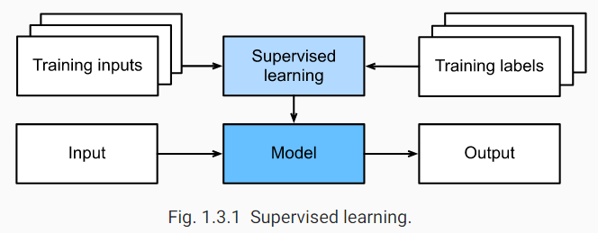
Kinds of Machine Learning: Supervised learning
The learning process looks something like this:
Grab a big collection of examples for which the covariates are known.
select a random subset, acquiring the ground truth labels for each.
These inputs and corresponding labels comprise the training set.
We feed the training dataset into a supervised learning algorithm.
Learning algorithm is a function that takes as input a dataset and outputs another function, the learned model.
Finally, we feed unseen inputs to the learned model, using its outputs as predictions of the corresponding label.

Slide 26
Supervised learning
Supervised learning
Regression
Classification
Tagging
Search and ranking
Recommender systems
Sequence Learning

Slide 27
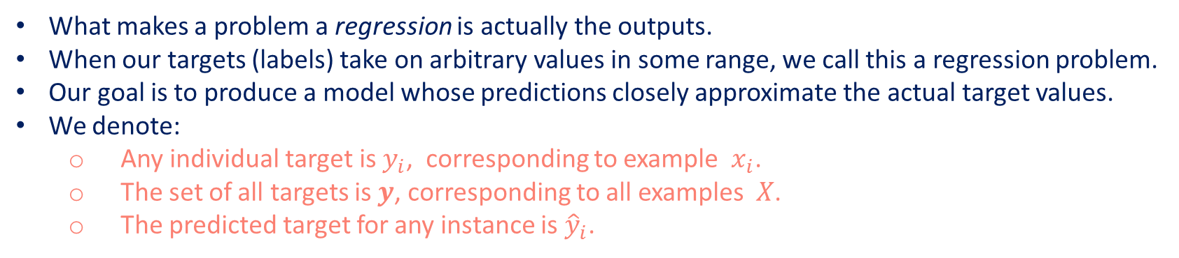
Supervised learning: Regression
Supervised learning
Regression
Classification
Tagging
Search and ranking
Recommender systems
Sequence Learning
What makes a problem a regression is actually the outputs.
When our targets (labels) take on arbitrary values in some range, we call this a regression problem.
Our goal is to produce a model whose predictions closely approximate the actual target values.
We denote:
Any individual target is $y_{i}$, corresponding to example $x_{i}$.
The set of all targets is $y$, corresponding to all examples $X$.
The predicted target for any instance is ${\hat{y}}_{i}$.
Lots of practical problems are well-described regression problems. Examples:
Predicting the rating that a user will assign to a movie.
Predicting the length of stay for patients in the hospital.

Slide 28
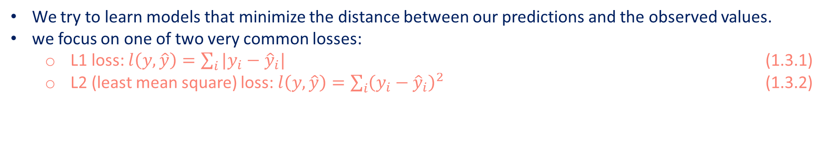
Supervised learning: Regression
Supervised learning
Regression
Classification
Tagging
Search and ranking
Recommender systems
Sequence Learning
A good rule of thumb is that any How much? or How many? problem should suggest regression.
“How many hours will this surgery take?”
“How many dogs are in this photo?”
We try to learn models that minimize the distance between our predictions and the observed values.
we focus on one of two very common losses:
L1 loss: $l\left(y,\hat{y}\right)=\sum_{i}{|y_{i}−{\hat{y}}_{i}|}$ (1.3.1)
L2 (least mean square) loss: $l\left(y,\hat{y}\right)=\sum_{i}{{\left(y_{i}−{\hat{y}}_{i}\right)}^{2}}$ (1.3.2)
The L2 loss corresponds to the assumption that our data was corrupted by Gaussian noise.
The L1 loss corresponds to an assumption of noise from a Laplace distribution.

Slide 29
Supervised learning: Classification
Supervised learning
Regression
Classification
Tagging
Search and ranking
Recommender systems
Sequence Learning
In classification,
Our model looks at a feature vector.
Then predict which category (class), among some (discrete) set of options, an example belongs.
For hand-written digits, we might have 10 classes, corresponding to the digits 0 through 9.
Making a model to understand hand-written digits given a photo, this is optical character recognition (OCR) task.
The feature vector for a photo that contain a digit is the pixel values in an image.

Slide 30
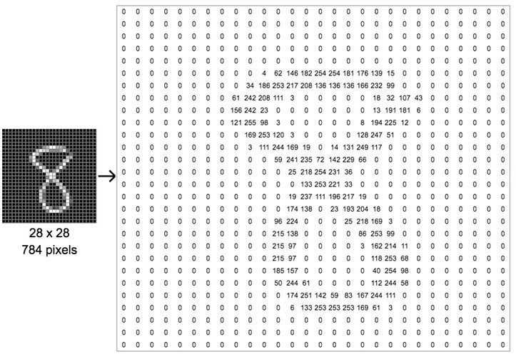
Supervised learning: Classification
Supervised learning
Regression
Classification
Tagging
Search and ranking
Recommender systems
Sequence Learning
The feature vector for a photo that contain a digit is the pixel values in an image.
source: https://www.ovh.com/blog/deep-learning-explained-to-my-8-year-old-daughter/

Slide 31
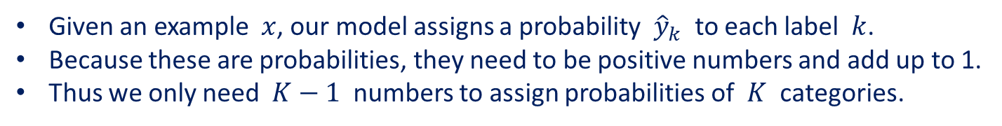
Supervised learning: Classification
Supervised learning
Regression
Classification
Tagging
Search and ranking
Recommender systems
Sequence Learning
The simplest form of classification is when there are only two classes, a problem which we call binary classification.
In regression, we sought a regressor to output a real value $\hat{y}$ .
In classification, we seek a classifier, whose output $\hat{y}$ is the predicted class assignment.
It can be hard to optimize a model that can only output a hard categorical assignment.
It is usually much easier to instead express our model in the language of probabilities.
Given an example $x$, our model assigns a probability ${\hat{y}}_{k}$ to each label $k$.
Because these are probabilities, they need to be positive numbers and add up to 1.
Thus we only need $K−1$ numbers to assign probabilities of $K$ categories.

Slide 32
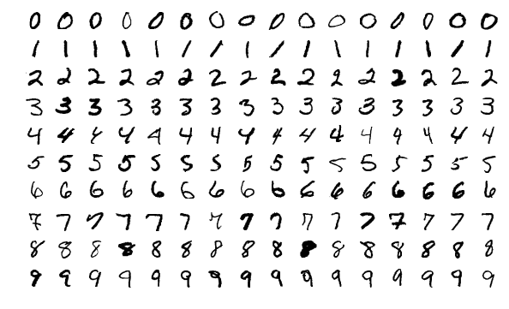
Supervised learning: Classification
Supervised learning
Regression
Classification
Tagging
Search and ranking
Recommender systems
Sequence Learning
When we have more than two possible classes, we call the problem multiclass classification.
Common examples include hand-written character recognition.
The common loss function for classification problems is called cross-entropy.
Hand-written digits from MNIST. Source: https://en.wikipedia.org/wiki/MNIST_database

Slide 33
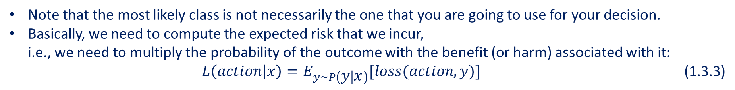
Supervised learning: Classification
Supervised learning
Regression
Classification
Tagging
Search and ranking
Recommender systems
Sequence Learning
Note that the most likely class is not necessarily the one that you are going to use for your decision.
Basically, we need to compute the expected risk that we incur, i.e., we need to multiply the probability of the outcome with the benefit (or harm) associated with it: $L\left(action | x\right)=E_{y\sim P\left(y | x\right)}[loss(action,y)]$ (1.3.3)
Classification can get much more complicated than just binary, multiclass, or even multi-label classification.
For instance, there are some variants of classification for addressing hierarchies.
This is referred to as hierarchical classification.
Hierarchies assume that there exist some relationships among the many classes.
Not all errors are equal—if we must err, we prefer to misclassify to a related class rather than to a distant class.

Slide 34
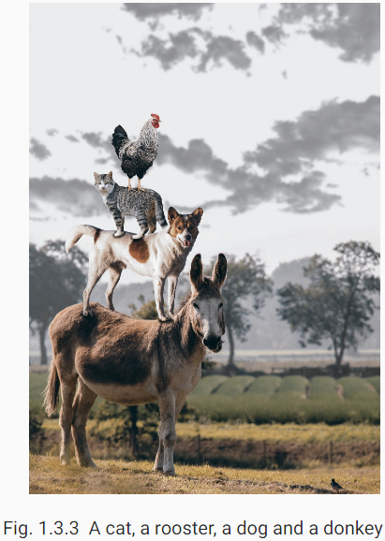
Supervised learning: Tagging
Supervised learning
Regression
Classification
Tagging
Search and ranking
Recommender systems
Sequence Learning
Some classification problems do not fit neatly into the binary or multiclass classification setups.
The problem of learning to predict classes that are not mutually exclusive is called multi-label classification.
Auto-tagging problems are typically best described as multi-label classification problems.
The model can say the image depicts a cat, a dog, a donkey, a rooster, and a bird.
We also have to deal with this kind of problem when dealing with the biomedical literature, where correctly tagging allows researchers to do exhaustive reviews of the literature.

Slide 35
Supervised learning: Search and ranking
Supervised learning
Regression
Classification
Tagging
Search and ranking
Recommender systems
Sequence Learning
In the field of information retrieval, we want to impose a ranking on a set of items.
Take web search for example, the goal is less to determine whether a particular page is relevant for a query, but rather, which one of the plethora of search results is most relevant for a particular user.
We care about the ordering of the relevant search results.
Our learning algorithm needs to produce ordered subsets of elements from a larger set.
One solution to this problem is to
First assign to every element in the set a corresponding relevance score
Then to retrieve the top-rated elements

Slide 36
Supervised learning: Search and ranking
Supervised learning
Regression
Classification
Tagging
Search and ranking
Recommender systems
Sequence Learning
PageRank, the original secret sauce behind the Google search engine was an early example of such a scoring system but it was peculiar in that it did not depend on the actual query.
Here they relied on a simple relevance filter to identify the set of relevant items and then on PageRank to order those results that contained the query term.
Nowadays, search engines use machine learning and behavioural models to obtain query-dependent relevance scores.

Slide 37
Supervised learning: Recommender systems
Supervised learning
Regression
Classification
Tagging
Search and ranking
Recommender systems
Sequence Learning
Recommender systems are another problem setting that is related to search and ranking.
The problems are similar insofar as the goal is to display a set of relevant items to the user.
The main difference is the emphasis on personalization to specific users in the context of recommender systems.
Examples: movie, retail products, music, or news recommendation.
In some cases, customers provide explicit feedback communicating how much they liked a particular product (e.g., the product ratings and reviews on Amazon, IMDB, GoodReads, etc.).
In some other cases, they provide implicit feedback, e.g., by skipping titles on a playlist.
These systems are trained to estimate some score $y_{ij}$, such as an estimated rating or the probability of purchase, given a user $u_{i}$ and product $p_{j}$ .

Slide 38
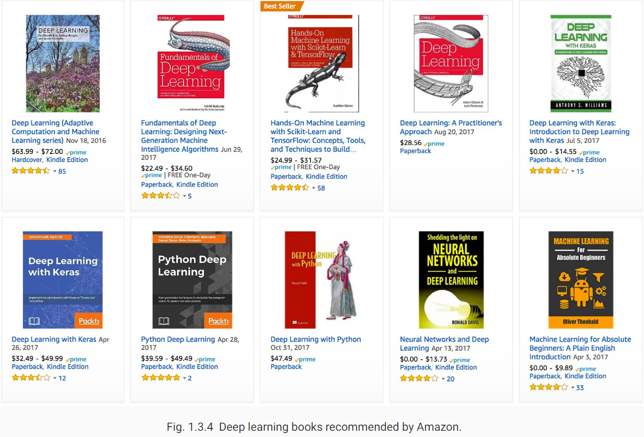
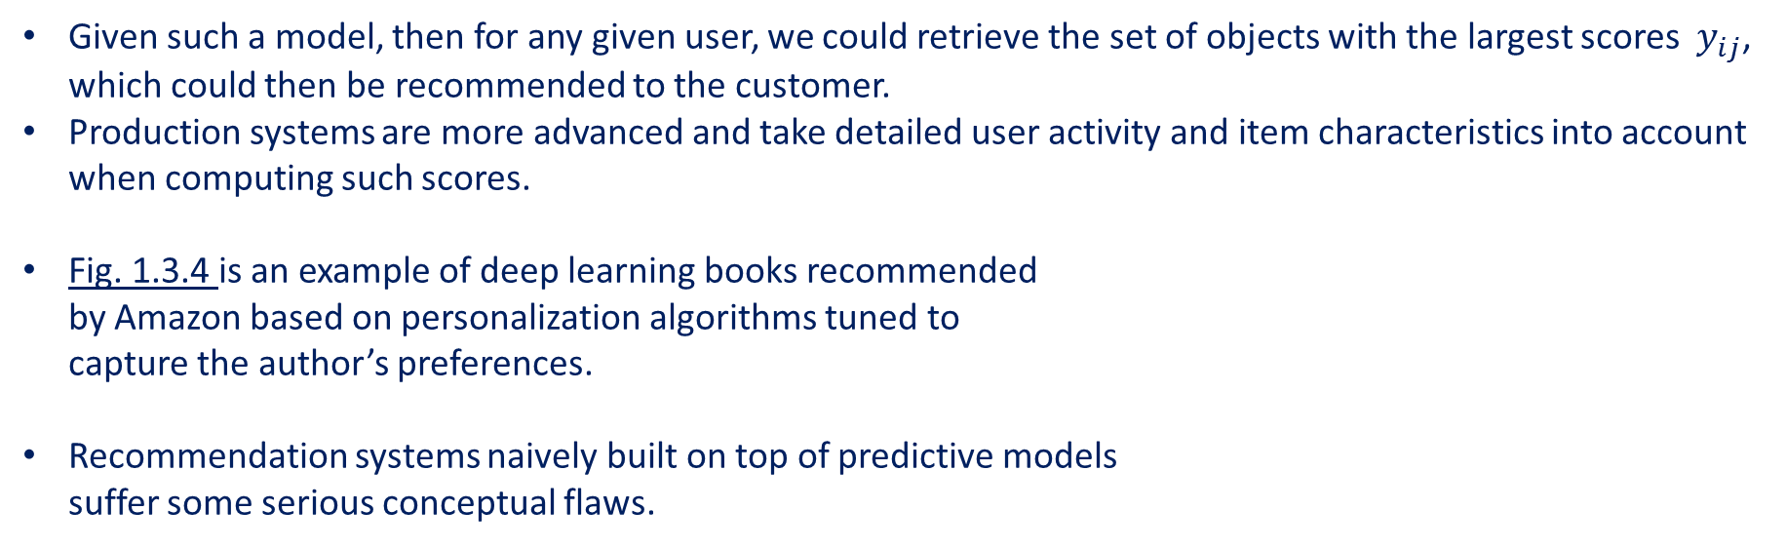
Supervised learning: Recommender systems
Supervised learning
Regression
Classification
Tagging
Search and ranking
Recommender systems
Sequence Learning
Given such a model, then for any given user, we could retrieve the set of objects with the largest scores $y_{ij}$, which could then be recommended to the customer.
Production systems are more advanced and take detailed user activity and item characteristics into account when computing such scores.
Fig. 1.3.4 is an example of deep learning books recommended by Amazon based on personalization algorithms tuned to capture the author’s preferences.
Recommendation systems naively built on top of predictive models suffer some serious conceptual flaws.

Slide 39
Supervised learning: Sequence Learning
Supervised learning
Regression
Classification
Tagging
Search and ranking
Recommender systems
Sequence Learning
How would we deal with dataset that consists of video snippets?
In this case, each snippet might consist of a different number of frames.
Our guess of what is going on in each frame might be much stronger if we take into account the previous or succeeding frames.
One popular deep learning problem is machine translation: the task of ingesting sentences in some source language and predicting their translation in another language.
These problems also occur in medicine.
We would not want the model to throw away everything it knows about the patient history each hour and just make its predictions based on the most recent measurements.

Slide 40
Supervised learning: Sequence Learning
Supervised learning
Regression
Classification
Tagging
Search and ranking
Recommender systems
Sequence Learning
These problems are instances of sequence learning.
They require a model to either ingest sequences of inputs or to emit sequences of outputs (or both!).
These latter problems are sometimes referred to as seq2seq problems.
Some types of sequence transformations:
Tagging and Parsing.
Automatic Speech Recognition.
Text to Speech.
Machine Translation.

Slide 41
Supervised learning: Sequence Learning
Supervised learning
Regression
Classification
Tagging
Search and ranking
Recommender systems
Sequence Learning
Tagging and Parsing.
This involves annotating a text sequence with attributes.
The goal is to decompose and annotate text based on structural and grammatical assumptions to get some annotation.
Examples:
We might want to know where the verbs and subjects are.
we might want to know which words are the named entities.

Slide 42

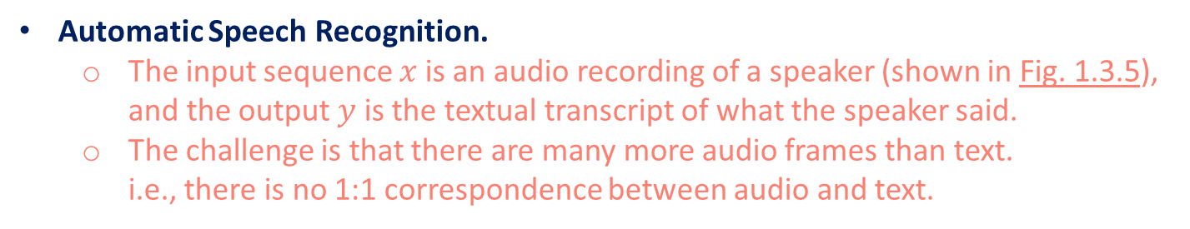
Supervised learning: Sequence Learning
Supervised learning
Regression
Classification
Tagging
Search and ranking
Recommender systems
Sequence Learning
Automatic Speech Recognition.
The input sequence $x$ is an audio recording of a speaker (shown in Fig. 1.3.5), and the output $y$ is the textual transcript of what the speaker said.
The challenge is that there are many more audio frames than text. i.e., there is no 1:1 correspondence between audio and text.

Slide 43
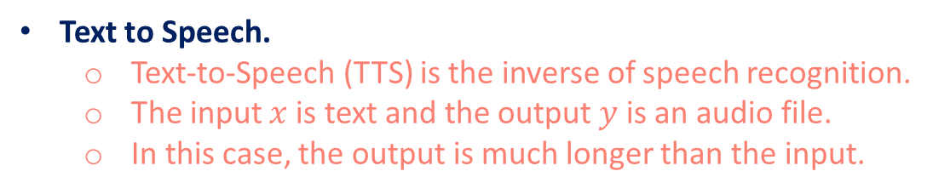
Supervised learning: Sequence Learning
Supervised learning
Regression
Classification
Tagging
Search and ranking
Recommender systems
Sequence Learning
Text to Speech.
Text-to-Speech (TTS) is the inverse of speech recognition.
The input $x$ is text and the output $y$ is an audio file.
In this case, the output is much longer than the input.
Machine Translation.
Unlike the case of speech recognition, where corresponding inputs and outputs occur in the same order
in machine translation, order inversion can be vital.
In this case, the output is much longer than the input.

Slide 44
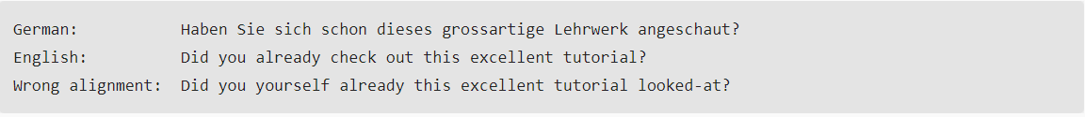
Supervised learning: Sequence Learning
Supervised learning
Regression
Classification
Tagging
Search and ranking
Recommender systems
Sequence Learning
Machine Translation.
Unlike the case of speech recognition, where corresponding inputs and outputs occur in the same order, in machine translation, order inversion can be vital.
while we are still converting one sequence into another, neither the number of inputs and outputs nor the order of corresponding data examples are assumed to be the same.
Consider the following example of the peculiar tendency of Germans to place the verbs at the end of sentences.

Slide 45
Contents
CH1
A Motivating Example
The Key Components
Kinds of Machine Learning
Roots
The Road to Deep Learning
Success Stories
Summary
Data
Supervised learning
Models
Unsupervised learning
Objective functions
Interacting with an Environment
Optimization algorithms
Reinforcement learning

Slide 46
Kinds of Machine Learning: Unsupervised learning
All the examples so far were related to Supervised Learning, i.e., situations where we feed the model a dataset containing both the features and corresponding target values.
In a completely opposite way, there is another class of problems called unsupervised learning.
Unsupervised learning is about training a model to find patterns in a unlabeled dataset.
Some unsupervised learning techniques:
Clustering: Grouping related examples.
Principal component analysis (PCA): The process of computing the principal components and using them to perform a change of basis on the data. (https://en.wikipedia.org/wiki/Principal_component_analysis)
Representation learning: Used to describe entities and their relations, such as Rome − Italy + France = Paris.
Probabilistic graphical models: Used to describe the root causes of much of the data that we observe. For instance, if we have demographic data about house prices, pollution, crime, location, education, salaries, etc., can we discover how they are related simply based on empirical data?
Generative adversarial networks (GANs): These give us a procedural way to synthesize data, even complicated structured data like images and audio.

Slide 47
Contents
CH1
A Motivating Example
The Key Components
Kinds of Machine Learning
Roots
The Road to Deep Learning
Success Stories
Summary
Data
Supervised learning
Models
Unsupervised learning
Objective functions
Interacting with an Environment
Optimization algorithms
Reinforcement learning

Slide 48
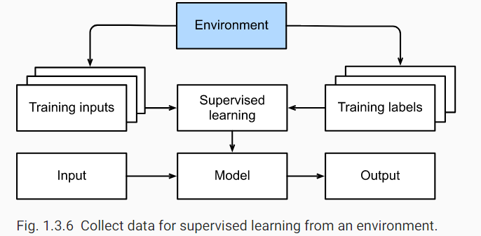
Kinds of Machine Learning: Interacting with an Environment
Supervised and unsupervised learning do not address
where data actually comes from,
or what actually happens when a machine learning model generates an output.
In either case, we grab a big pile of data upfront, then set our pattern recognition machines in motion without ever interacting with the environment again; this called offline learning.
In offline learning, all of the learning takes place after the algorithm is disconnected from the environment.
For supervised learning, the process looks like Fig. 1.3.6.

Slide 49
Kinds of Machine Learning: Interacting with an Environment
The upside of offline learning is we can worry about pattern recognition in isolation, without any distraction from these other problems. But the downside is that the problem formulation is quite limiting.
Artificially intelligent bots capable of making predictions and taking actions in the world.
These actions impact the environment.
If we want to train an intelligent agent, we must account for the way its actions might impact the future observations of the agent.
Considering the interaction with an environment opens a whole set of new modeling questions. Does the environment:
Remember what we did previously?
Want to help us, e.g., a user reading text into a speech recognizer?
Want to beat us, i.e., an adversarial setting like spam filtering (against spammers) or playing a game (vs an opponent)?
Not care (as in many cases)?
Have shifting dynamics (does future data always resemble the past or do the patterns change over time, either naturally or in response to our automated tools)?

Slide 50
Contents
CH1
A Motivating Example
The Key Components
Kinds of Machine Learning
Roots
The Road to Deep Learning
Success Stories
Summary
Data
Supervised learning
Models
Unsupervised learning
Objective functions
Interacting with an Environment
Optimization algorithms
Reinforcement learning

Slide 51
Kinds of Machine Learning: Reinforcement learning
Reinforcement learning (RL) is used to develop an agent that interacts with an environment and takes actions.
This might include applications to
Robotics.
Dialogue systems.
AI for video games.
The behaviour of an RL agent is governed by a policy.
A policy is just a function that maps from observations (of the environment) to actions.
The goal of reinforcement learning is to produce a good policy.
We can cast any supervised learning problem as an RL problem.
For a classification problem. We could create an RL agent with one action corresponding to each class.
Then create an environment which gave a reward that was exactly equal to the loss function from the original supervised problem.
RL can also address many problems that supervised learning cannot.
For example, in supervised learning we expect that the training input comes associated with the correct label. But in RL, we do not assume that for each observation, the environment tells us the optimal action.

Slide 52
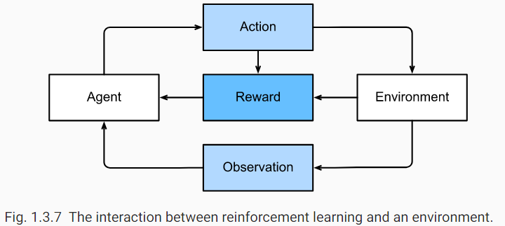
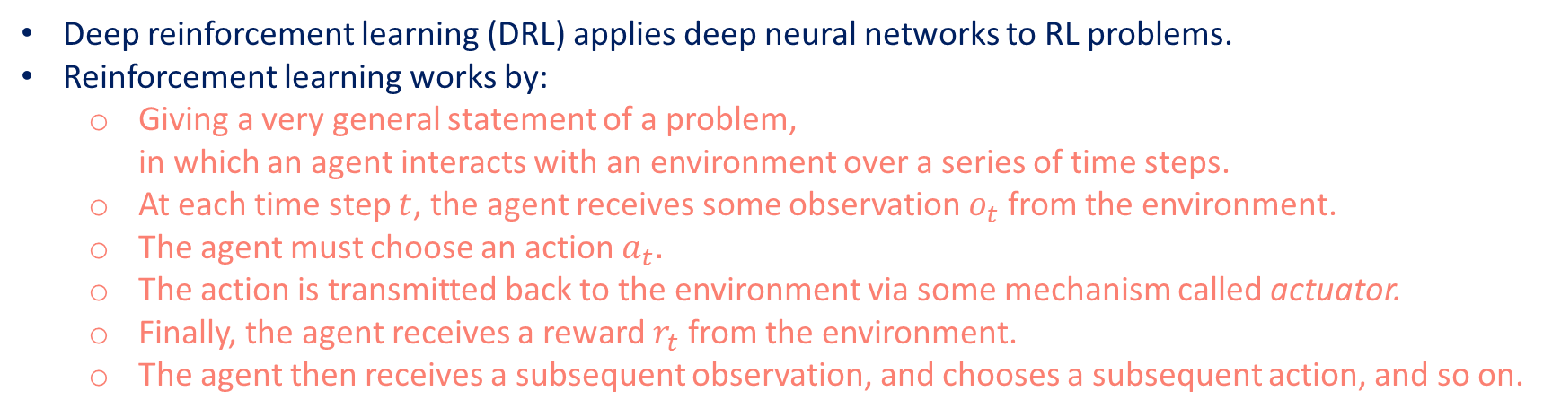
Kinds of Machine Learning: Reinforcement learning
Deep reinforcement learning (DRL) applies deep neural networks to RL problems.
Reinforcement learning works by:
Giving a very general statement of a problem, in which an agent interacts with an environment over a series of time steps.
At each time step $t$, the agent receives some observation $o_{t}$ from the environment.
The agent must choose an action $a_{t}.$
The action is transmitted back to the environment via some mechanism called actuator.
Finally, the agent receives a reward $r_{t}$ from the environment.
The agent then receives a subsequent observation, and chooses a subsequent action, and so on.

Slide 53
Kinds of Machine Learning: Reinforcement learning
Reinforcement learners may also have to deal with the problem of partial observability. That is, the current observation might not tell you everything about your current state.
Reinforcement learners might know of one good policy, but there might be many other better policies that the agent has never tried.
The reinforcement learner must constantly choose whether
to exploit the best currently-known strategy as a policy,
or to explore the space of strategies, potentially giving up some short-run reward in exchange for knowledge.
When the environment is fully observed, we call the RL problem a Markov Decision Process (MDP).
When the state does not depend on the previous actions, we call the problem a contextual bandit problem.
When there is no state, just a set of available actions with initially unknown rewards, this problem is the classic multi-armed bandit problem.

Slide 54
Contents
CH1
A Motivating Example
The Key Components
Kinds of Machine Learning
Roots
The Road to Deep Learning
Success Stories
Summary
Data
Supervised learning
Models
Unsupervised learning
Objective functions
Interacting with an Environment
Optimization algorithms
Reinforcement learning

Slide 55
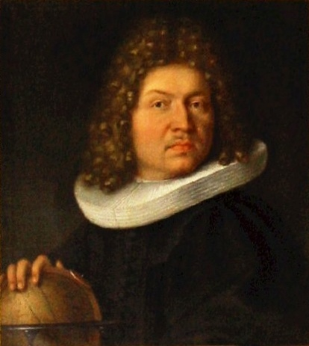
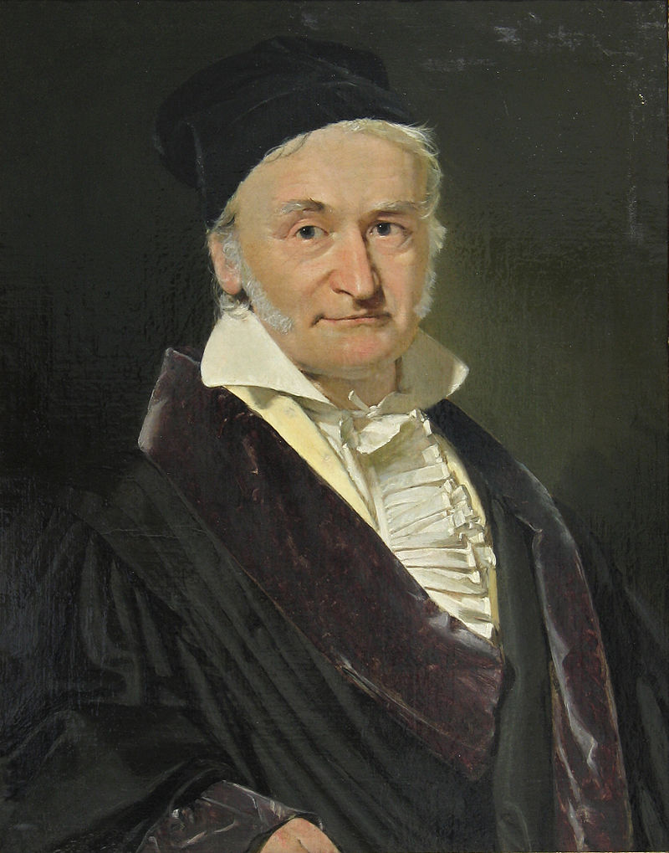
Roots
Although many deep learning methods are recent inventions, humans have held the desire to analyze data and to predict future outcomes for centuries.
Examples:
Bernoulli distribution by Jacob Bernoulli (1655-1705).
Gaussian distribution by Carl Friedrich Gauss (1777-1855).
These tools gave rise to an experimental approach in the natural sciences.
Jacob Bernoulli (also known as James or Jacques) (1654 – 1705)
Portrait of Carl Friedrich Gauß (1777-1855)

Slide 56
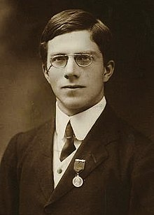
Roots
The geometry book of Jacob Köbel (1460-1533) illustrates averaging the length of 16 adult men’s feet to obtain the average foot length.
The 16 adult men were asked to line up in a row.
Their aggregate length was then divided by 16 to obtain an estimate for what now amounts to 1 foot.
An image of Ronald Fisher in 1913
Statistics really took off with the collection and availability of data.
Ronald Fisher (1890-1962), contributed significantly to its theory and also its applications in genetics.
Fisher introduced Linear Discriminant Analysis algorithm, and Fisher Information Matrix formula.
Also, Fisher released Iris dataset that used to illustrate machine learning algorithms.

Slide 57
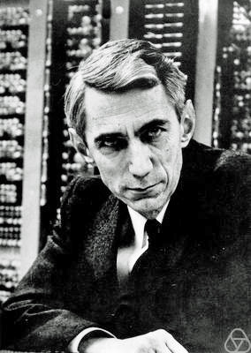
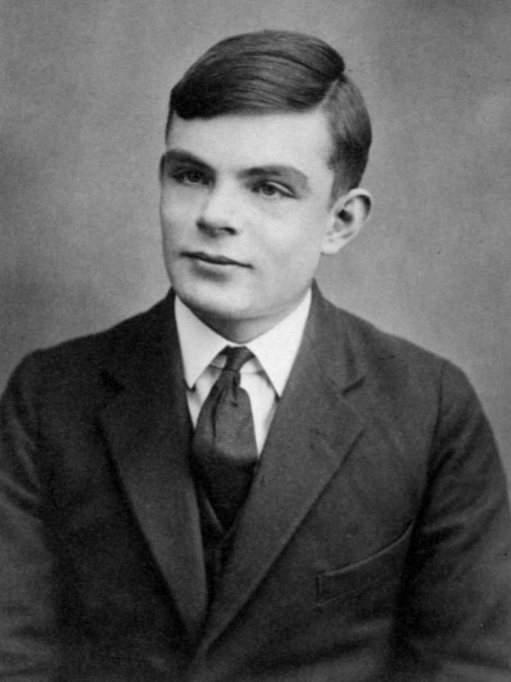
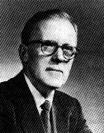
Roots
A second influence for machine learning came from Information Theory (Claude Shannon, 1916-2001) and the Theory of computation via Alan Turing (1912-1954).
Another influence can be found in neuroscience and psychology.
Donald Hebb (1904-1985) posited that neurons learn by positive reinforcement.
This became known as the Hebbian learning rule.
It is the prototype of Rosenblatt’s perceptron learning algorithm and it laid the foundations of many stochastic gradient descent algorithms.
Claude Elwood Shannon (1916 – 2001)
Alan Turing at age 16
Donald Olding Hebb (1904 –1985)

Slide 58
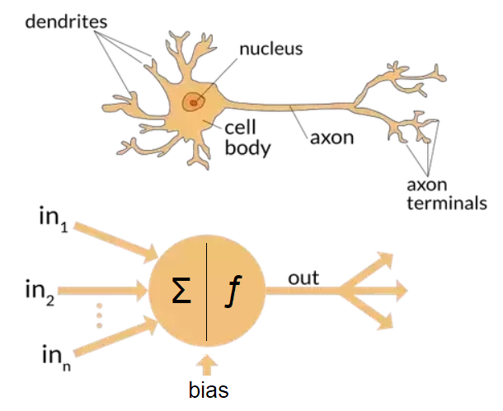
Roots
Biological inspiration is what gave neural networks their name.
Researchers have tried to assemble computational circuits that resemble networks of interacting neurons.
A few key principles that can be found in most networks today:
The alternation of linear and nonlinear processing units, often referred to as layers.
The use of the chain rule (known as backpropagation) for adjusting parameters in the entire network at once.
The differences between Artificial and Biological Neural Network

Slide 59
Roots
Research in neural networks languished from around 1995 until 2005. This was due to a number of reasons:
Training a network is computationally very expensive.
RAM was plentiful at the end of the past century.
Computational power was scarce.
Datasets were relatively smallــ MNIST with its 60,000 handwritten digits was considered huge.
Sample images from MNIST test dataset

Slide 60
Contents
CH1
A Motivating Example
The Key Components
Kinds of Machine Learning
Roots
The Road to Deep Learning
Success Stories
Summary
Data
Supervised learning
Models
Unsupervised learning
Objective functions
Interacting with an Environment
Optimization algorithms
Reinforcement learning

Slide 61
The Road to Deep Learning
Algorithms and models that seemed computationally infeasible became relevant (and vice versa). This is best illustrated in Table 1.5.1.
Table 1.5.1 Dataset vs. computer memory and computational power
Decade | Dataset | Memory | Floating Point Calculations per Second
1970 | 100 (Iris) | 1 KB | 100 KF (Intel 8080)
1980 | 1 K (House prices in Boston) | 100 KB | 1 MF (Intel 80186)
1990 | 10 K (optical character recognition) | 10 MB | 10 MF (Intel 80486)
2000 | 10 M (web pages) | 100 MB | 1 GF (Intel Core)
2010 | 10 G (advertising) | 1 GB | 1 TF (Nvidia C2050)
2020 | 1 T (social network) | 100 GB | 1 PF (Nvidia DGX-2)
It is evident that RAM has not kept pace with the growth in data.

Slide 62
The Road to Deep Learning
Statistical models needed to become more memory efficient (by adding nonlinearities) while simultaneously being able to spend more time on optimizing these parameters, due to an increased compute budget.
Machine learning and statistics moved from (generalized) linear models and kernel methods to deep networks.
The list below scratches the surface of the ideas that have helped researchers achieve tremendous progress:
Novel methods for capacity control, such as Dropout [Srivastava et al., 2014] have helped to mitigate the danger of overfitting.
Attention mechanisms addressed the problem of increasing the memory and complexity of a system without increasing the number of learnable parameters.
Multi-stage designs, e.g., via the Memory Networks (MemNets) [Sukhbaatar et al., 2015] and the Neural Programmer-Interpreter [Reed & DeFreitas, 2015] allowed statistical modelers to describe iterative approaches to reasoning.
Invention of GANs [Goodfellow et al., 2014].
Building parallel distributed training algorithms and parallelizing computations.
Development of deep Learning frameworks.

Slide 63


The Road to Deep Learning
The first generation of frameworks allowing for easy modeling encompassed Caffe, Torch, and Theano.
High level APIs: TensorFlow, Keras, CNTK, Caffe 2, and Apache MxNet.
The third generation of tools, namely imperative tools for deep learning, was arguably spearheaded by Chainer, which used a syntax similar to Python NumPy to describe models. This idea was adopted by both PyTorch, the Gluon API of MXNet, and Jax.
The division of labor between systems researchers building better tools and statistical modelers building better networks has greatly simplified things.
For instance, training a linear logistic regression model used to be a nontrivial homework problem, worthy to give to new machine learning PhD students at Carnegie Mellon University in 2014.
By now, this task can be accomplished with less than 10 lines of code, putting it firmly into the grasp of programmers.

Slide 64
Contents
CH1
A Motivating Example
The Key Components
Kinds of Machine Learning
Roots
The Road to Deep Learning
Success Stories
Summary
Data
Supervised learning
Models
Unsupervised learning
Objective functions
Interacting with an Environment
Optimization algorithms
Reinforcement learning

Slide 65
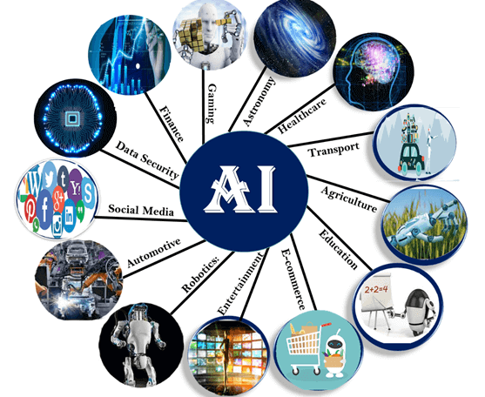
Success Stories
Intelligent assistants, such as Apple’s Siri, Amazon’s Alexa, or Google’s assistant are able to answer spoken questions with a reasonable degree of accuracy.
A key ingredient in digital assistants is the ability to recognize speech accurately.
Object recognition likewise has come a long way. Estimating the object in a picture was a challenging task in 2010.
Games agents such as chess and AlphaGo.
The advent of self-driving cars and trucks.
Applications of AI

Slide 66
Contents
CH1
A Motivating Example
The Key Components
Kinds of Machine Learning
Roots
The Road to Deep Learning
Success Stories
Summary
Data
Supervised learning
Models
Unsupervised learning
Objective functions
Interacting with an Environment
Optimization algorithms
Reinforcement learning

Slide 67
Summary
Machine learning studies how computer systems can leverage experience (often data) to improve performance at specific tasks. It combines ideas from statistics, data mining, artificial intelligence, and optimization. Often, it is used as a means of implementing artificially-intelligent solutions.
As a class of machine learning, representational learning focuses on how to automatically find the appropriate way to represent data. This is often accomplished by a progression of learned transformations.
Much of the recent progress in deep learning has been triggered by an abundance of data arising from cheap sensors and Internet-scale applications, and by significant progress in computation, mostly through GPUs.
Whole system optimization is a key component in obtaining good performance. The availability of efficient deep learning frameworks has made design and implementation of this significantly easier.

